Slide 1

Health Conditions and Recovery Analysis
A Statistical Overview of Regional and Gender-based Trends
Presented by Uloh C. Armstrong

Slide 2
Regional Distribution of Cases
Total cases: 290 distributed across four regions.
The West region reported the highest cases (80), while the South recorded the lowest (62).
East and North regions had comparable totals of 73 and 75, respectively.
The gender distribution revealed more male cases (151) compared to females (130).
9 cases were classified as 'Other' gender.

Slide 3
Symptoms and Recovery Outcomes
Headache (68 cases) and cough (64 cases) were the most reported symptoms.
Recovery rates were highest among patients with headache and fever.
Critical and deceased outcomes were significantly lower compared to improving and recovered statuses.
Total critical cases: 32; total fatalities: 12.

Slide 4
Disease Prevalence by Region
Malaria had the highest prevalence with 84 cases, followed by COVID-19 with 69 cases.
The East and West regions showed significant cases of malaria and COVID-19.
Typhoid was more prominent in the North, with 19 cases reported.
Flu was the least reported disease, with 17 cases.

Slide 5
Age Group Analysis
Age 21-40 reported the highest number of cases (71), followed by 1-20 (63).
Malaria had the most balanced age distribution, with high cases across all age groups.
Older age groups (61-100) showed higher rates of COVID-19 and typhoid.
Common cold was more prominent in younger age groups (1-40).

Slide 6
Treatment and Recovery Rates
Medication was the most utilized treatment method, with 99 cases and a 52% success rate.
Rest and hydration showed recovery rates of 57% and 58%, respectively.
Surgery, though least utilized, had a lower success rate (31%).
Therapy demonstrated moderate outcomes, with 46% success and significant critical cases.

Slide 7
Gender and Disease Trends
Malaria was the most reported disease across all genders, with 45 male cases and 36 female cases.
COVID-19 had a similar pattern, affecting 38 males and 29 females.
Flu cases were minimal, with no reports for the 'Other' gender category.
Typhoid showed a slight male dominance (31 cases) over females (29).

Slide 8
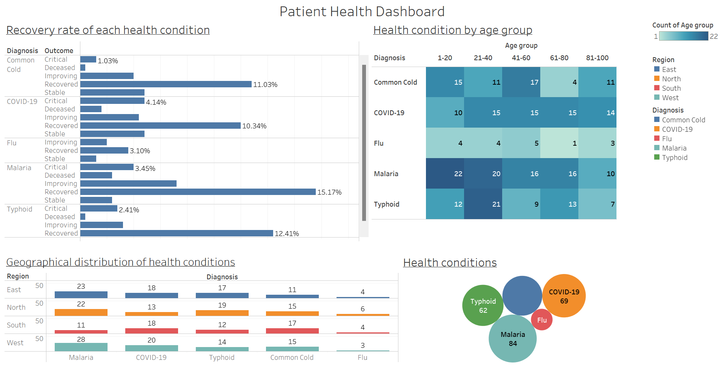
Tableau Dashboard
The analysis highlights malaria and COVID-19 as the most prevalent diseases in Nigeria.
Recovery outcomes are highest with medication, rest, and hydration.
Age, region, and gender are significant factors influencing disease prevalence and outcomes.

Slide 9
Conclusion
This analysis highlights malaria and COVID-19 as the most prevalent diseases in Nigeria.
Recovery outcomes are highest with medication, rest, and hydration.
Age, region, and gender are significant factors influencing disease prevalence and outcomes.

